Slide 1

ARDUINO – Day4 – Part 1
BIOE 3090

Slide 2

Activity 7 – Blink_3090 – Debounce
Using
pbLastDebounceTime
pbDebounceDelay
digitalRead()
Millis()
Create
pb_debounce function
Now with Pushbutton Action!!!!

Slide 3
Program Flowchart Debounce
Loop
check_pushbutton()
Begin
N
If
Y
Pb_debounce()
Pin Definitions
Pushbutton pressed
PB_PIN
If
pbLatch = true
Setup
Pushbutton is
Still pressed PB_PIN
Blink_timer()
N
If
Y
blink_led()
Elapsed Time > Switch Time
&& pbLatch == true

Slide 4
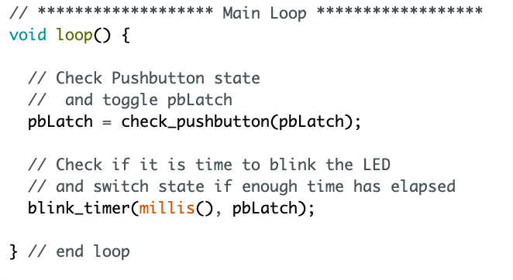
Polling with Debounce
Changed Function Here
Passing pbLatch

Slide 5
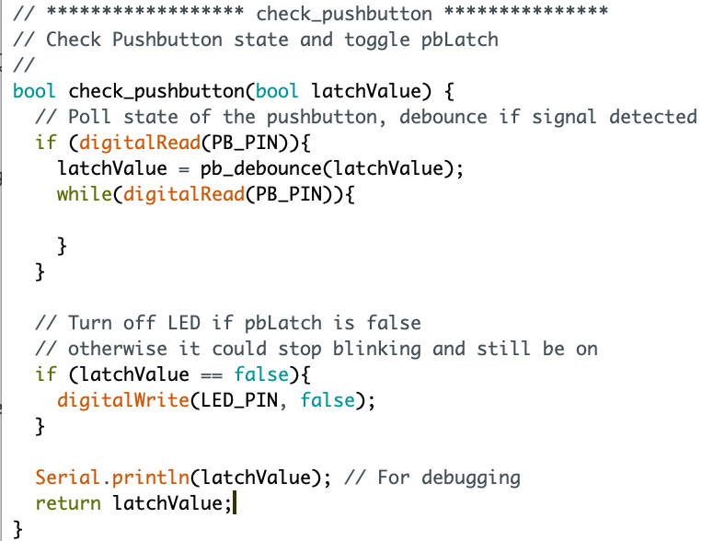
Check Pushbutton
pb_debounce fcn called
here

Slide 6
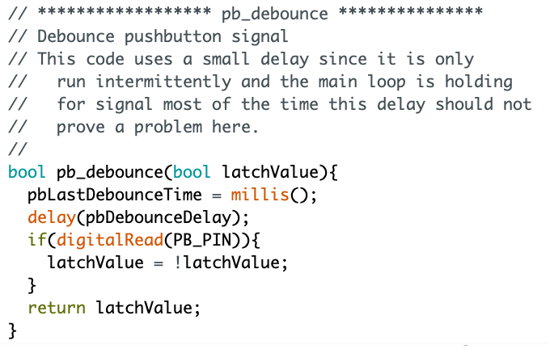
Debounce Code
Return variable type
Very small delay
If button still pressed after delay, latch PB
Return variable

Slide 7
ARDUINO – Day4 – Part 2
BIOE 3090

Slide 8
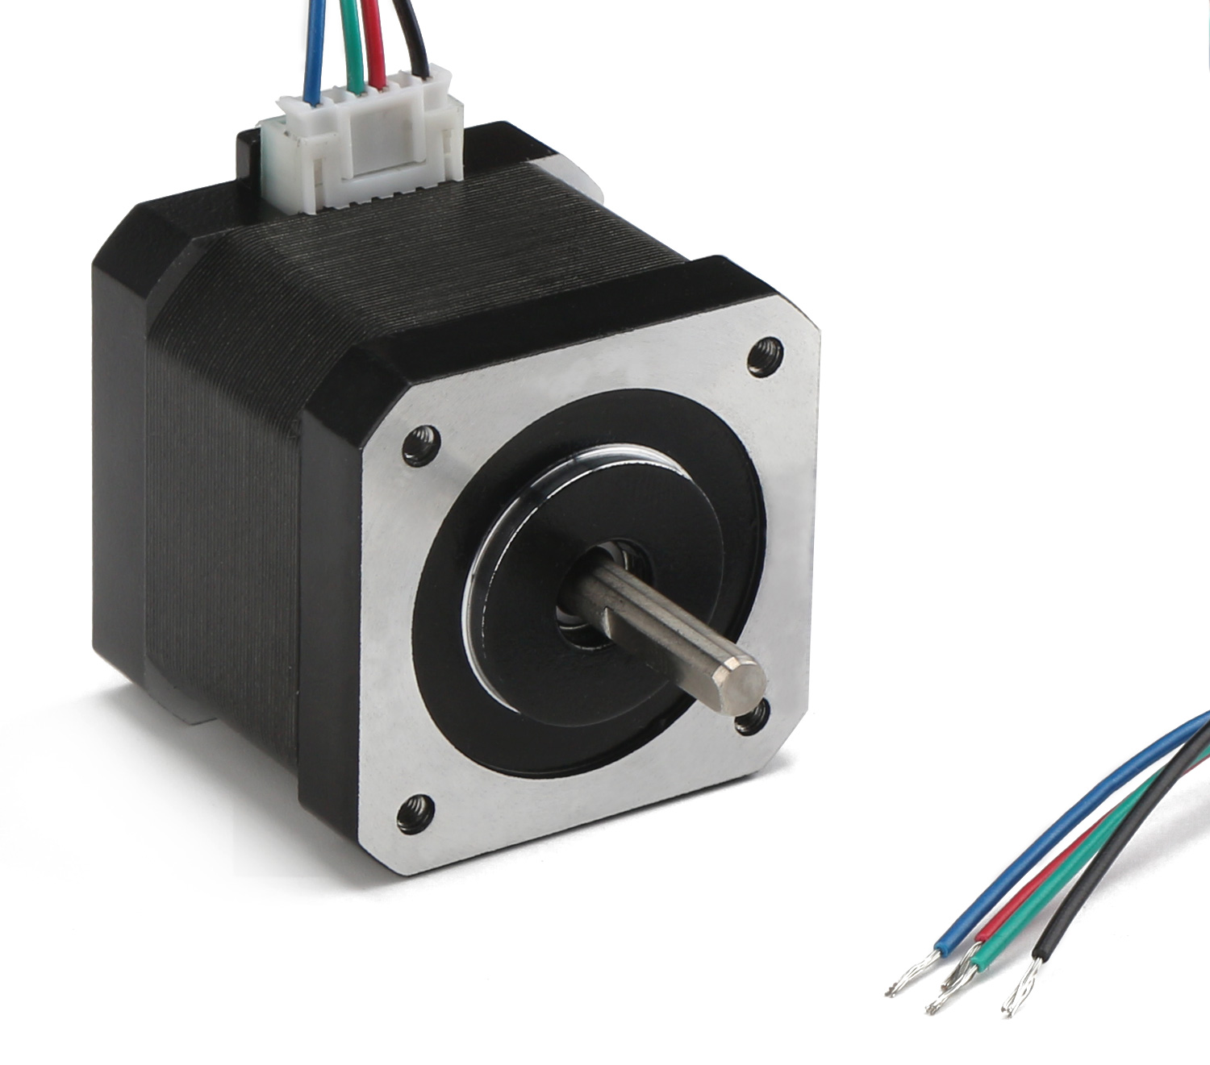
Stepper Motors
Brushless DC motor
200 positions / rotation
1.8 degrees
High torque
Low speed
Accurate rotational positioning
Needs to be indexed

Slide 9
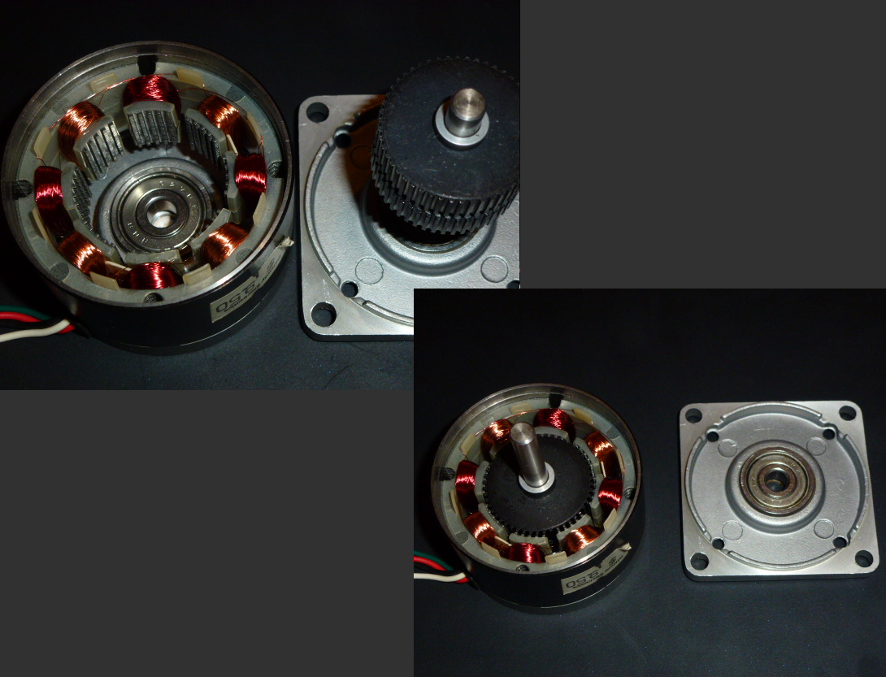


Stepper Motors
4-Wire
Basic Bi-polar stepper
6-Wire
Unipolar Stepper
High Torque
Low Speeds

Slide 10
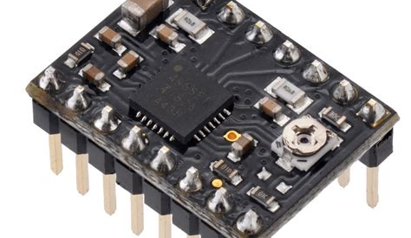

Stepper Motor Drivers
Forward / Reverse
Dir Pin
1-step / low – high signal
Step Pin
Microstepping
MS1
MS2
MS3
12 V Motor Supply
VOMT
Enabled Low
Enable (bar)

Slide 11
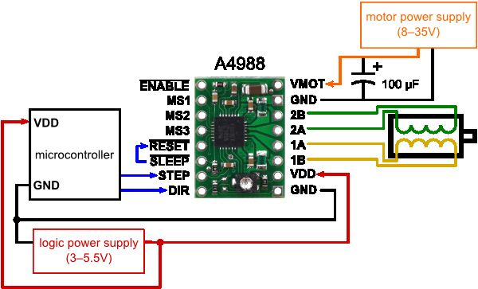






Stepper Motor Driver Wiring
Keep 12V separate from 5V & Arduino pins!
GND
Jumpered
Polarity Matters
Arduino
Header
Wiring different here.

Slide 12
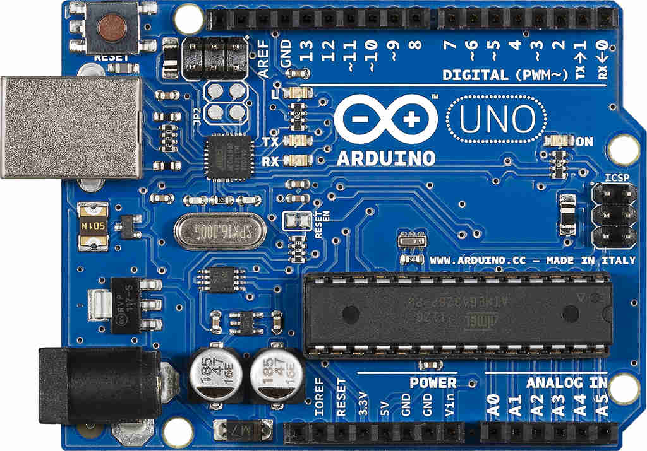
5V Power Wiring
USB to Computer
To Breadboard and Stepper Driver
GND
5V

Slide 13
Activity 8 – Stepper Motor - Wiring
Using
Provided parts
Stepper Motor Driver Wiring Diagram
Create
Stepper motor and driver on breadboard with Arduino LED
Motor Action!!!!

Slide 14
Program Flowchart Run Stepper
Loop
check_pushbutton()
Begin
N
If
Y
Pb_debounce()
Pin Definitions
Pushbutton pressed
PB_PIN
If
pbLatch = true
Setup
Pushbutton is
Still pressed PB_PIN
Blink_timer()
N
If
Y
blink_led()
Elapsed Time > Switch Time
&& pbLatch == true
run_stepper()

Slide 15
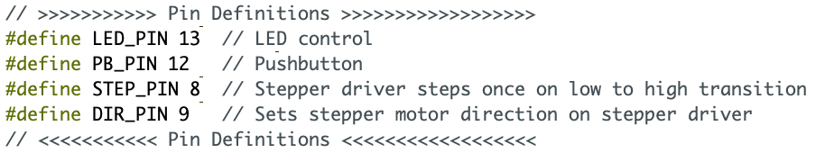
Stepper Pins

Slide 16
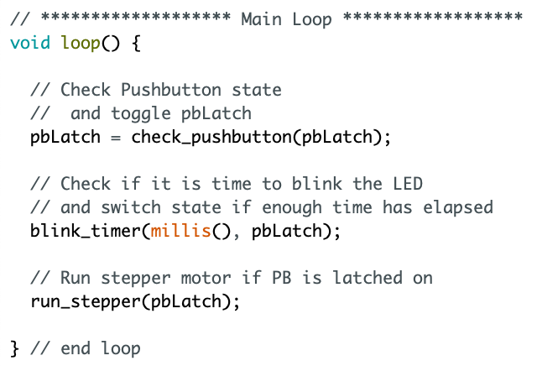
In Main Loop
New Function

Slide 17
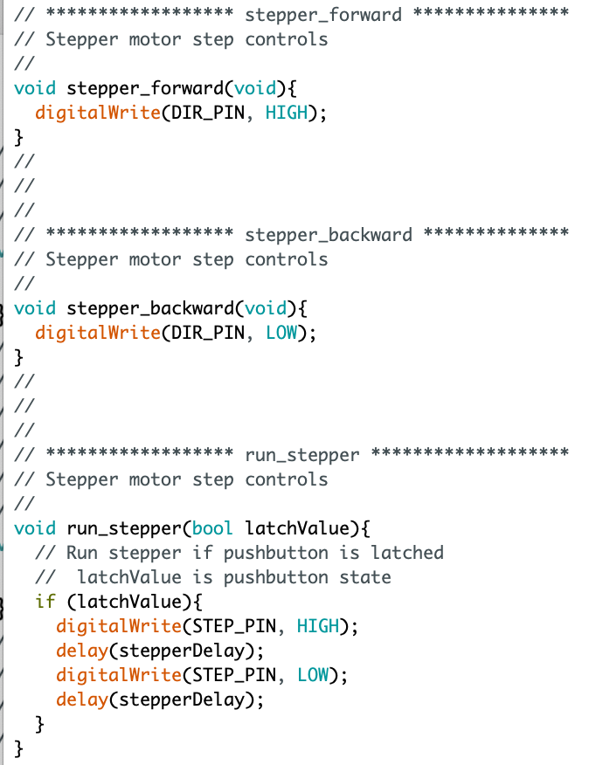
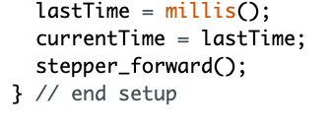
Functions - Stepping
In Setup

Slide 18







ISR timer is a better way
Interrupt
Service
Routine
Hijack Timer1 on Microcontroller
We are not going to do this…

Slide 19
Activity 9 – Stepper Motor Programming
Using
STEP_PIN
DIR_PIN
Create
Stepper_forward()
Stepper_backward()
Run_stepper()
Motor Action!!!!

Slide 20
Project Pump

Slide 21
In-Class
Translate User Story into User Needs
Translate User Needs into Requirements
Build Design Output matrix based on Requirements
Verification Matrix
Validation Matrix

Slide 22
Verification
Validation

Slide 23
Verification - The evaluation of whether or not a product, service, or system complies with a regulation, requirement, specification, or imposed condition. It is often an internal process.
Validation - The assurance that a product, service, or system meets the needs of the customer and other identified stakeholders. It often involves acceptance and suitability with external customers.
https://en.wikipedia.org/wiki/Verification_and_validation

